Slide 1

SSL/TLS Webserver & webcrawler
Robert Campbell

Slide 2
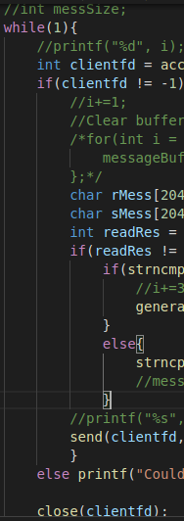
Objective:
Modify a working HTTP Webserver to function with TLS/SSL encryption
Modify a working HTTP Webcrawler to function with TLS/SSL encryption
Programs should be able to communicate with each other, standard web browsers, and remote webservers

Slide 3
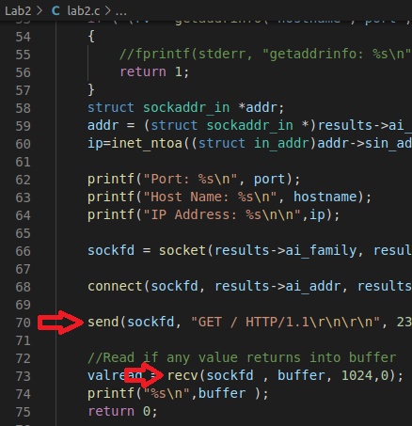
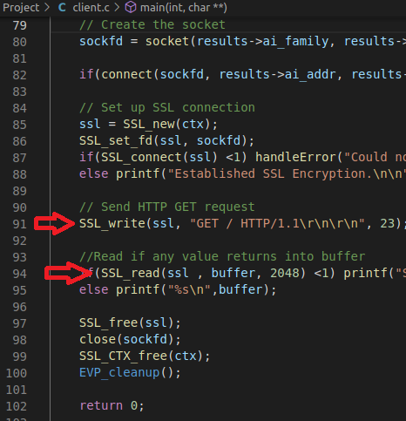

Slide 4
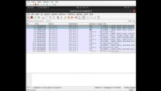
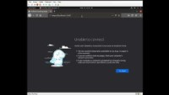
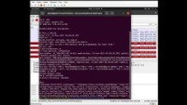
Demo:

Slide 5
Questions?

